Slide 1
Good Team
15146311 Jun Nyeong Nam
15146314 Yang Seung hyuck

Slide 2


Preview
Preview
Team
Environment
Architecture
Core Technology
Development Process
Part-time necessary function
Provide the necessary features for both part-timers and bosses
monthly/weekly/daily salary calculations
+
Personal schedule management
+
Human Resource management
Boss necessary function

Slide 3


Preview
Preview
Team
Environment
Architecture
Core Technology
Development Process
Doctor salary
Feature: manage schedule for part-time job
Calculate their salary
Limitation: cannot communicate their manager(boss)
albam
Feature: boss can manage alba schedule and check attendance
Managing own attendance for part time job
Limitation: if manager do not use this app part-time worker do not use this app
Lack of function for part-time job

Slide 4
Team
Preview
Team
Environment
Architecture
Core Technology
Development Process
Team Composition
Project Planning part
Implementation Part
Leader: Jun Nyeong Nam
Leader: Seung Hyuck Yang
member: Seung Hyuck Yang
Member: Jun Nyeong Nam
Design Part
Sever part
Leader: Jun Nyeong Nam
Leader: Seung Hyuck Yang
member: Seung Hyuck Yang
Member: Jun Nyeong Nam

Slide 5
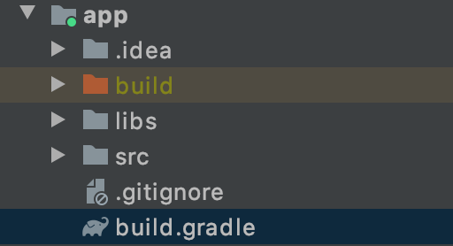


Environment
Preview
Team
Environment
Architecture
Core Technology
Development Process
Module
FrameWork
Client
APP
Spring Boot
Android Studio
One Module
Relatively small app volumes
unnecessary of module division
Software with experience(partial parts)
Hope to develop Spring-based rest API
Learning Kotlin
Optimal solution for making android app

Slide 6
Architecture
Preview
Team
Environment
Architecture
Core Technology
Development Process
Fragment
Data
Function
Fragment
Data
Function
Fragment Type
Log in / sign up
Mainframe
Schedule for boss/worker
Calculation salary for boss/worker
My page
Job-hunting for boos/worker
Manage Human Resource schedule and salary
etc
Data Type
User
Branch
Workers for Branch
Job
Work
Announcement
Job-hunting
Application
# Worker - employee
Job - Part-time Job type
Work - Part-time schedule (individual work unit)
#Boss - Manager
Branch – Their whole business establishment
Worker- their employee
Work- Part-time and my schedule (individual work unit)
Function description
Login/Sign up
Toolbar
Day enrollment
Job enrollment
Job list
Attendance check
Branch enrollment
Worker enrollment
Worker enrollment
Worker schedule manipulation
Salary calculation
Salary specification
Payment calculation
Payment specification
Information modification
Announcement enrollment
Branch filter
Jobhunting enrollment
Jobhunting application

Slide 7
Architecture
Preview
Team
Environment
Architecture
Core Technology
Development Process
Fragment Rough Design

Slide 8
Architecture
Preview
Team
Environment
Architecture
Core Technology
Development Process
Fragment Rough Design

Slide 9
Architecture
Preview
Team
Environment
Architecture
Core Technology
Development Process
Fragment Rough Design

Slide 10
Architecture
Preview
Team
Environment
Architecture
Core Technology
Development Process
Database Structure

Slide 11
Architecture
Preview
Team
Environment
Architecture
Core Technology
Development Process
Database Structure

Slide 12
Architecture
Preview
Team
Environment
Architecture
Core Technology
Development Process
Function

Slide 13
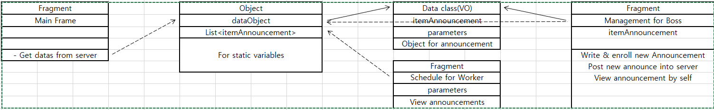
Architecture
Preview
Team
Environment
Architecture
Core Technology
Development Process
Class Diagram
Common classes
Object for easy controlling variables
dataObject : Object
Fragments for each main pages
workerMainFrame : Fragment
workerSchedule
workerCalculation
workerJobhunting
workerMypage
bossSchedule
bossManagement
bossCalculation
bossJobhunting
bossMypage
Data Class for each variables(VO)
itemAnnouncement : VO
itemWork
itemJob
itemBranch
itemUser
itemWorker
itemJobhunting
itemApplication
etcs

Slide 14

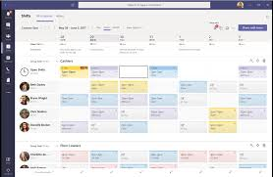
Core Technology
Preview
Team
Environment
Architecture
Core Technology
Development Process
Schedule, Management
Boss
Worker
Enrollment
Manage own schedule
Manage branch situation(worker enroll or branch enroll)
Manage part-timer schedule
Enrollment
Job enrollment
Manage Own schedule

Slide 15

Core Technology
Preview
Team
Environment
Architecture
Core Technology
Development Process
Calculation
Boss
Worker
Payment calculation (entire payment, unpaid payment)
Closer look for their Payment
salary calculation (entire salary, unpaid salary)
Closer look for their salary

Slide 16
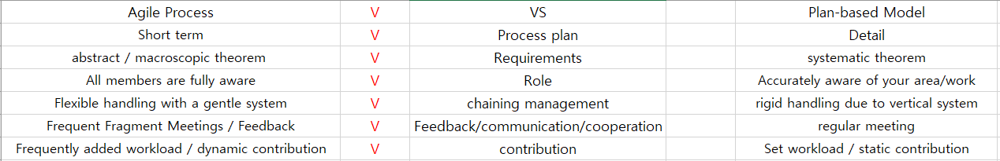
Development Process
Preview
Team
Environment
Architecture
Core Technology
Development Process
Agile Process

Slide 17
Development Process
Preview
Team
Environment
Architecture
Core Technology
Development Process
Milestone
Layout and Fragment completion(11/02)
Primary Secondary function implementation (11//29
Environment: Android Studio
Core Technology Implementation (11/15)
Debug and completion(12/06)
Implementation Plan
Server Plan
Environment : Spring boot
Using Kakao API auto login implementation
(11/01)
Debug and Completion(12/06)
Spring boot - Oracle 연동(11/01)
기타 / 추가되는 기능 구현(11/29)

